Slide 1




Dos and Don’ts of Unpaid Work Experiences as a Path to Employment
David Hoff
Institute for Community Inclusion
University of Massachusetts, Boston

Slide 2
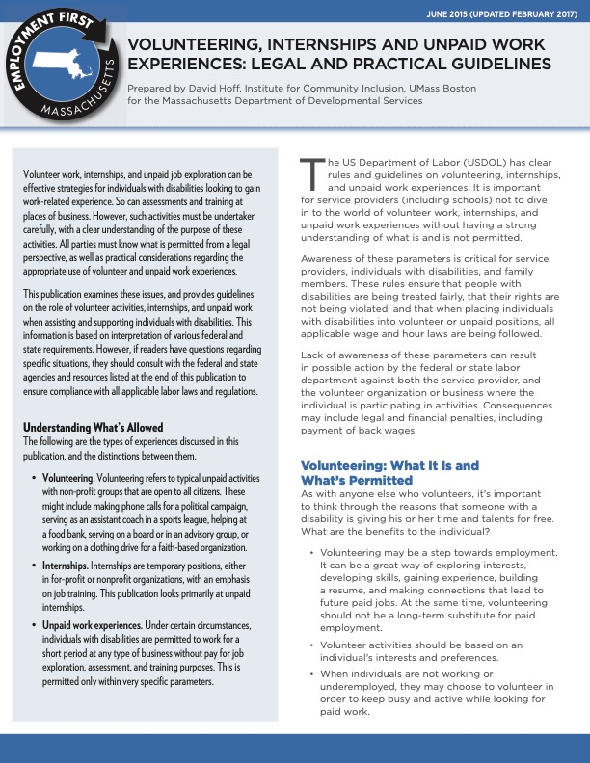
Publication with Details
Publication with Details

Slide 3
Why This Topic is Important
Appropriate use of volunteering, internships, and unpaid work
Individual rights fully respected
Stay out of trouble

Slide 4

Important note about this presentation
Information is based on interpretation of various federal & state laws and regulations
Not official legal guidance
Consult with appropriate federal and state agencies and resources regarding specific situations

Slide 5
What are we talking about?
Volunteering | Internships | Unpaid Work Experiences
Unpaid activities Non-profit organizations only Open to all individuals | Paid or unpaid Non-profit or for-profit organization Temporary position Emphasis on job training and education Open to all individuals | Non-profit or for-profit organization Used for job exploration, assessment, training Limited hours & specific circumstances Only for people with disabilities

Slide 6

Guiding Principles
Based on individual’s preferences, interests, goals
Self-determination and choice
Not just to
“stay busy” “fill time”

Slide 7

Volunteering
Icon vector created by rawpixel.com - www.freepik.com

Slide 8

Why volunteer?
Why does anyone volunteer?
Step towards employment
  But not a long-term substitute for paid employment
Keep busy and active while looking for work
Community activity, pursue a personal interest

Slide 9

Volunteer Guidelines
Only at non-profit organizations
No expectation of payment or benefit
Generally part-time
Activities typically associated with volunteering
Person is truly “volunteering” - free will
No displacement of regular employees
Parent/guardian must grant permission to volunteer
Volunteer Guidelines

Slide 10

Unpaid Internships

Slide 11

Why intern?
Develop skills in a real work environment that can be applied in a variety of employment settings

Slide 12


Can an internship be unpaid?
DETERMINED BY PRIMARY BENEFICIARY TEST
What is the economic reality?
Who is the primary beneficiary?
Individual
Business

Slide 13
Unpaid Internships 7 Factors
No expectation of compensation
Similar to training in an educational environment - learning not earning
Tied to formal education program
Accommodates academic commitments by being tied to academic calendar
Time limited to period of beneficial learning
Individual complements but does not displace work of regular employees
Intern not entitled to job at end of internship
Guardian must be made aware that internship is unpaid

Slide 14

Internships:
Additional rules for MA
Interns must be paid at least minimum wage unless they are in 1 of 5 categories, including “people being rehabilitated or trained under rehabilitation or training programs in charitable, educational or religious institutions”.
Allows internships for individuals being assisted by service providers, as long as internship also complies with USDOL federal requirements.

Slide 15
Unpaid Work Experience

Slide 16






Why unpaid work experience?
Opportunity to use real work settings to:
  Explore interests
  Conduct assessments (situational assessment)
  Conduct job training

Slide 17
Types of Unpaid
Work Experiences
Vocational exploration: Identifying types of jobs individual may be interested in
Vocational assessment: Evaluating overall employment skills and interest/suitability for specific occupations
Vocational training: Developing skills for specific occupation, with expectation that individual will work in that occupation

Slide 18


Unpaid work experiences are permitted if all 7 of the following criteria are met

Slide 19
Criteria # 1
Person must have a disability
Competitive employment above minimum wage is not immediately obtainable
Needs intensive ongoing support to succeed in employment
Criteria
# 1

Slide 20
Criteria # 2
Criteria
# 2
Time spent at place of business is for vocational exploration, assessment or training
Must be conducted under general supervision of service provider or school staff

Slide 21
Criteria # 3
Employment in community must be goal of individual’s Vocational Rehabilitation Individual Plan for Employment (IPE), or Individualized Education Program (IEP) specifying need for exploration, assessment or training
ISP does not meet this criteria
Criteria
# 3

Slide 22
Criteria # 4:
Cannot result in immediate advantage to business
Not allowed:
Displacement of regular employees
Filling of vacant position
Relieving regular employees of assigned duties
Duties are of clear benefit to business
Direct supervision by employees of business
Activities conducted to accommodate labor needs of business
No limit in service plan on time spent at specific employer site or in specific job classification

Slide 23

Generally permissible under following hour limitations, per job experienced
Criteria
# 5
Vocational exploration: 5 hours
Vocational assessment: 90 hours
Vocational training: 120 hours

Slide 24
Criteria # 6
Individual is not entitled to a job at the place of business at end of unpaid work experience
However, if individual becomes employed at place of business, cannot be an unpaid trainee, unless they are working in a clearly different occupation
Criteria
# 6

Slide 25

Criteria # 7
Documentation to be provided to USDOL upon request indicating:
Individual is enrolled in community placement program
Enrollment is voluntary
No expectation of payment
Criteria
# 7
Information for USDOL

Slide 26
Alternatives for individuals not on an
Individualized Education Plan (IEP) or
Individualized Plan for Employment
(from vocational rehabilitation)

Slide 27
Issues to Consider

Slide 28

Dealing with concerns about possible injury
Generally, in MA individuals will fall under the business/organization workers’ compensation coverage.
Provide assurance to employer:
  Supervision
  Safety record
  Matching individuals to sites

Slide 29
Unpaid work experience as job “tryout”
Use as part of hiring process, if typical process (interview, testing, etc.) may exclude individual
Could be considered reasonable accommodation under the Americans with Disabilities Act

Slide 30

You can avoid dealing with the unpaid experience rules, by paying the individual.
But remember, that an employer/employee relationship will then exist between the individual and service provider

Slide 31
Volunteer, Internship, and Unpaid Work Examples

Slide 32

Example # 1
Example # 1
Individual is working as a volunteer receptionist at a non-profit, in hopes that they will be hired.
Business vector created by pch.vector - www.freepik.com

Slide 33

Example # 2
Example
# 2
A group of 4 special education students goes to a supermarket to retrieve carts for no pay as part of the school employment program.

Slide 34


Example # 3
Example
# 3
Individual has expressed interest in office work.
A 6-month unpaid internship is set up with a financial services firm, where the individual does filing, copying, and mail delivery.

Slide 35


Example # 4
Example
# 4
A local library often uses volunteers.
Individuals are volunteering to clean the library.

Slide 36

Example # 5
Example
# 5
Individual loses job after being competitively employed for a year.
An open position is identified at a restaurant.
Job developer offers employer an unpaid job tryout.
Photo courtesy of Pixabay.com

Slide 37

Example # 6
Example
# 6
Individual is interested in healthcare but has no experience.
Volunteer is placed in volunteer position at hospital, passing out periodicals and books to patients.

Slide 38

Example # 7
Individual is interested in working with flowers.
A 20-hour unpaid assessment is set up with the local florist to try out a variety of tasks.
Example
# 7
Photo courtesy of Pixabay.com

Slide 39

Overall Tips and Guidelines
OVERALL TIPS AND GUIDELINES
Be clear about type of activity
Clear rationale: Why these specific activities are being undertaken by an individual
Internships and unpaid work experiences used only as necessary, to lead to paid employment
Clear message: volunteering is not an alternative to paid employment
Know the laws and regulations
Document
Educate and communicate with individuals and families
Train staff

Slide 40


Resources
U.S. Department of Labor
Wage and Hour Division
Commonwealth of Massachusetts
Wage & Hour

Slide 41
Handouts
PowerPoint Slides
Information Brief
USDOL
Internship Fact Sheet
USDOL Non-Profit
and FLSA Fact Sheet

Slide 42

Contact Information
David Hoff
Office: 617-287-4308
Cell: 617-480-9230
david.hoff@umb.edu
www.communityinclusion.org

Slide 43


Questions, Comments,
Discussion

Slide 44
Thanks!

